Slide 1

Opening a new Bermese Restaurant in Toronto
Applied Data Science capstone
Report Prepared by : Mohamed Abuabchal
(https://github.com/abuabchal/testrepo/tree/main/Applied%20Data%20Science%20Capstone)

Slide 2
OUTLINE
Executive Summary
Introduction
Methodology
Results
Discussion
Conclusion

Slide 3
EXECUTIVE SUMMARY
This Capstone project focuses on identifying the most suitable location for opening an authentic Burmese restaurant in Toronto, Canada. Given the scarcity of Burmese restaurants in the area, this presents a potential business opportunity for an entrepreneur based in Canada. The entrepreneur aims to open the restaurant in neighborhoods where Asian cuisine is popular, leveraging the similarities between Burmese and other Asian foods.

Slide 4
Introduction
For this Capstone project, I am creating a hypothetical scenario for a concept Burmese restaurateur who wants to explore opening an authentic Burmese restaurant in Toronto area. The idea behind this project is that there may not be enough Burmese restaurants in Toronto and it might present a great opportunity for this entrepreneur who is based in Canada. As Burmese food is very similar to other Asian cuisines, this entrepreneur is thinking of opening this restaurant in locations where Asian food is popular (aka many Asian restaurants in the neighborhood). With the purpose in mind, finding the location to open such a restaurant is one of the most important decisions for this entrepreneur and I am designing this project to help him find the most suitable location.

Slide 5
Methodology
The overall methodology includes:
Data collection, wrangling, and formatting, using:
SpaceX API
Web scraping
Exploratory data analysis (EDA), using:
Pandas and NumPy
SQL
Data visualization, using:
Matplotlib and Seaborn
Folium

Slide 6
METHODOLOGY Data collection, wrangling, and formatting
First, I need to get the list of neighborhoods in Toronto, Canada. This is possible by extracting the list of neighborhoods from wikipedia page
(“ https://en.wikipedia.org/wiki/List_of_postal_codes_of_Canada:_M ”) I did the web scraping by utilizing pandas html table scraping method as it is easier and more convenient to pull tabular data directly from a web page into dataframe.
However, it is only a list of neighborhood names and postal codes. I will need to get their coordinates to utilize Foursquare to pull the list of venues near these neighborhoods. To get the coordinates, I tried using Geocoder package but it was not working so I used the csv file provided by IBM team to match the coordinates of Toronto neighborhoods. After gathering all these coordinates, I visualized the map of Toronto using Folium package to verify whether these are correct coordinates

Slide 7
METHODOLOGY Data collection, wrangling, and formatting
First, I need to get the list of neighborhoods in Toronto, Canada. This is possible by extracting the list of neighborhoods from wikipedia page
(“ https://en.wikipedia.org/wiki/List_of_postal_codes_of_Canada:_M ”) I did the web scraping by utilizing pandas html table scraping method as it is easier and more convenient to pull tabular data directly from a web page into dataframe.
However, it is only a list of neighborhood names and postal codes. I will need to get their coordinates to utilize Foursquare to pull the list of venues near these neighborhoods. To get the coordinates, I tried using Geocoder package but it was not working so I used the csv file provided by IBM team to match the coordinates of Toronto neighborhoods. After gathering all these coordinates, I visualized the map of Toronto using Folium package to verify whether these are correct coordinates

Slide 8
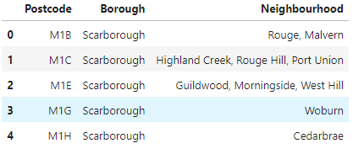
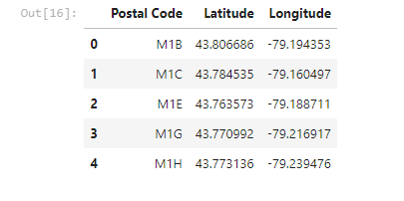
METHODOLOGY

Slide 9



METHODOLOGY Exploratory Data Analysis (EDA)
Pandas and NumPy
Functions from the Pandas and NumPy libraries are used to derive basic information about the data collected, which includes:
The number of launches on each launch site
The number of occurrence of each orbit
The number and occurrence of each mission outcome
SQL
The data is queried using SQL to answer several questions about the data such as:
The names of the unique launch sites in the space mission
The total payload mass carried by boosters launched by NASA (CRS)
The average payload mass carried by booster version F9 v1.1

Slide 10



METHODOLOGY Data Visualization
Matplotlib and Seaborn
Functions from the Matplotlib and Seaborn libraries are used to visualize the data through scatterplots, bar charts, and line charts.
The plots and charts are used to understand more about the relationships between several features, such as:
The relationship between flight number and launch site
The relationship between payload mass and launch site
The relationship between success rate and orbit type
Folium
Functions from the Folium libraries are used to visualize the data through interactive maps.
The Folium library is used to:
Mark all launch sites on a map
Mark the succeeded launches and failed launches for each site on the map
Mark the distances between a launch site to its proximities such as the nearest city, railway, or highway

Slide 11
METHODOLOGY Machine Learning Prediction
Functions from the Scikit-learn library are used to create our machine learning models.
The machine learning prediction phase include the following steps:
Standardizing the data
Splitting the data into training and test data
Creating machine learning models, which include:
Logistic regression
Support vector machine (SVM)
Decision tree
K nearest neighbors (KNN)
Fit the models on the training set
Find the best combination of hyperparameters for each model
Evaluate the models based on their accuracy scores and confusion matrix

Slide 12
RESULTS
The results are split into 5 sections:
SQL (EDA with SQL)
Matplotlib and Seaborn (EDA with Visualization)
Folium
Dash
Predictive Analysis
In all of the graphs that follow, class 0 represents a failed launch outcome while class 1 represents a successful launch outcome.

Slide 13
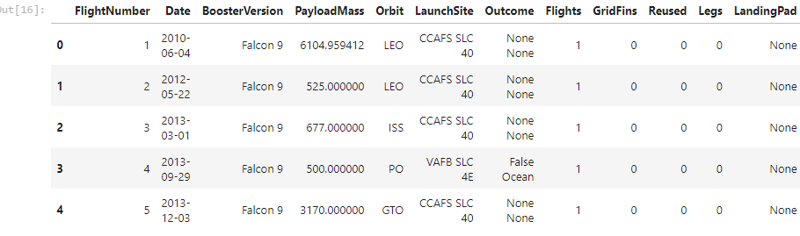
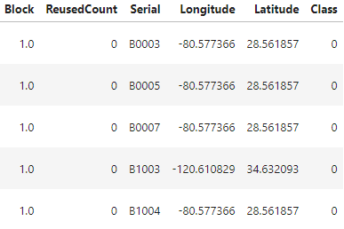
RESULTS SQL (EDA with SQL)

Slide 14
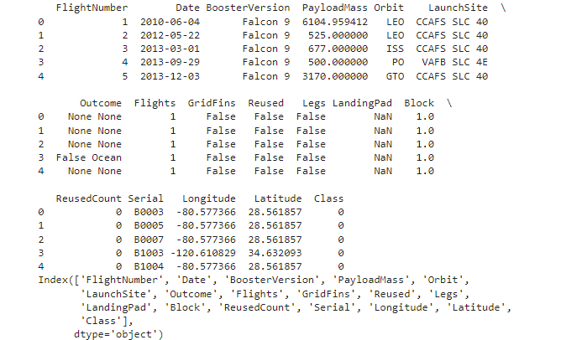
RESULTS SQL (EDA with SQL)

Slide 15
RESULTS SQL (EDA with SQL)

Slide 16
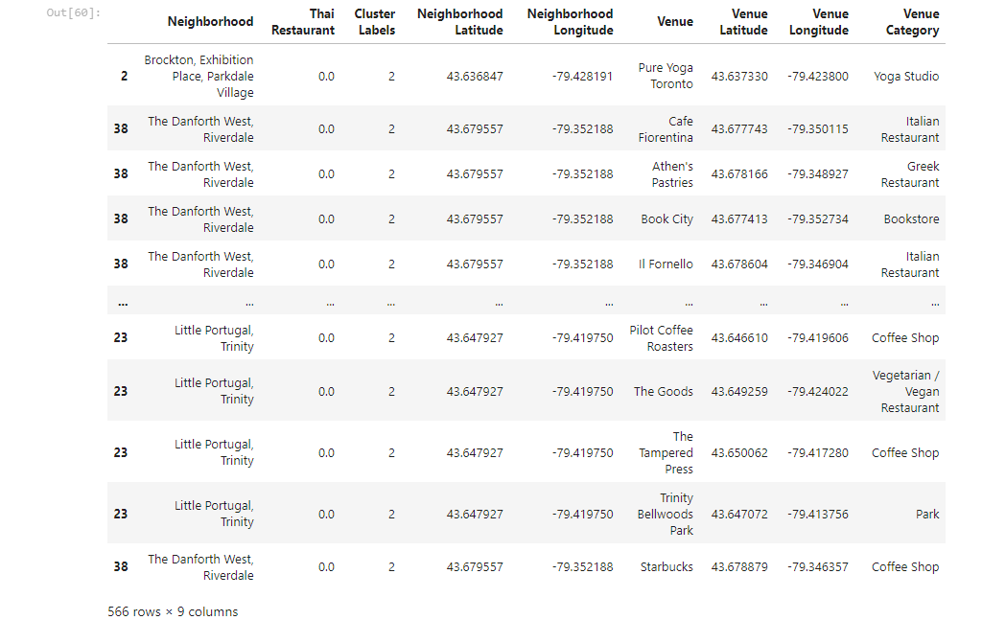
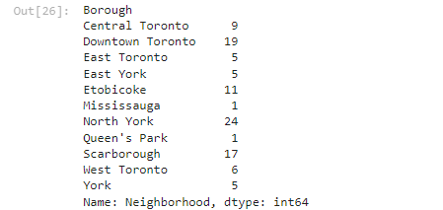
RESULTS SQL (EDA with SQL)
RESULTS
SQL (EDA with SQL)

Slide 17
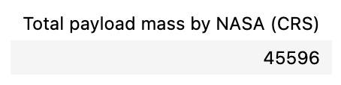

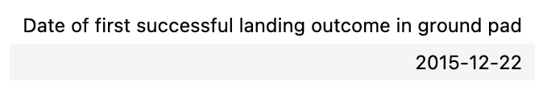
RESULTS SQL (EDA with SQL)
The total payload mass carried by boosters launched by NASA (CRS)
The average payload mass carried by booster version F9 v1.1
The date when the first successful landing outcome in ground pad was achieved

Slide 18
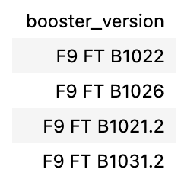
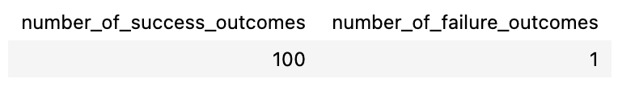
RESULTS SQL (EDA with SQL)
The names of the boosters which have success in drone ship and have payload mass greater than 4000 but less than 6000
The total number of successful and failure mission outcomes

Slide 19
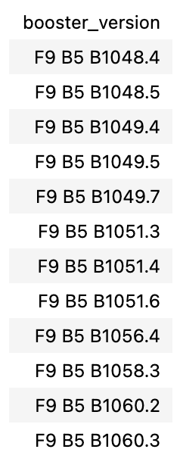
RESULTS SQL (EDA with SQL)
The names of the booster versions which have carried the maximum payload mass

Slide 20
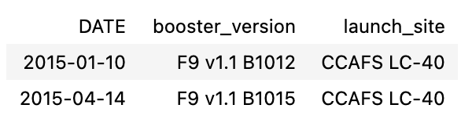
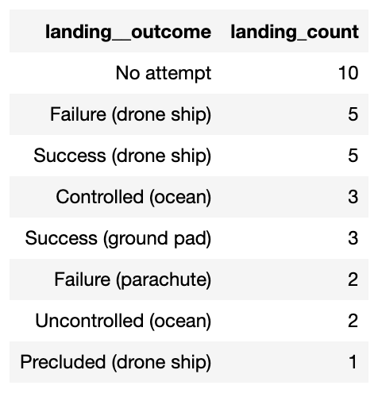
RESULTS SQL (EDA with SQL)
The failed landing outcomes in drone ship, their booster versions, and launch site names for in year 2015
The count of landing outcomes between the date 2010-06-04 and 2017-03-20, in descending order

Slide 21
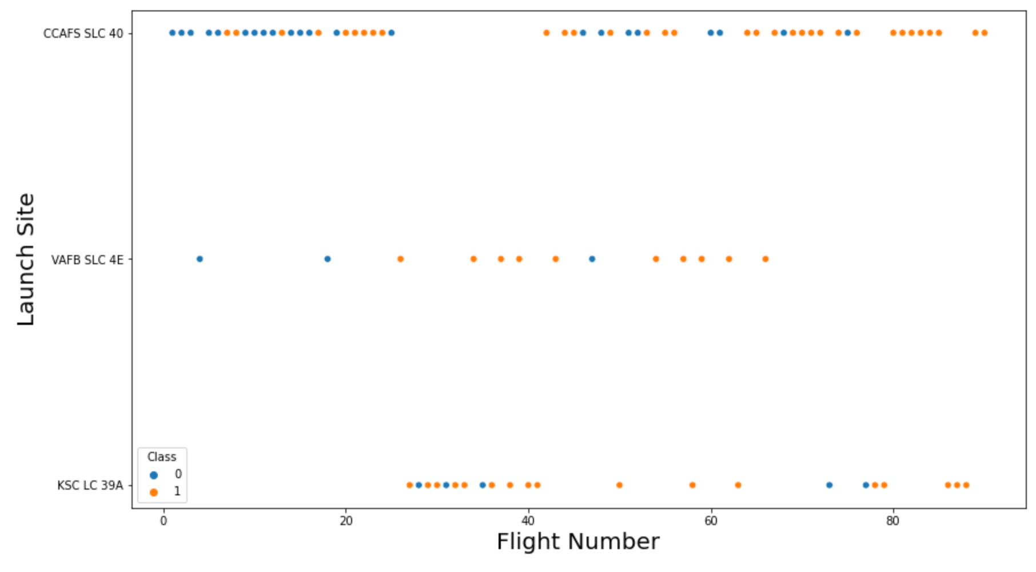
RESULTS Matplotlib and Seaborn (EDA with Visualization)
The relationship between flight number and launch site

Slide 22
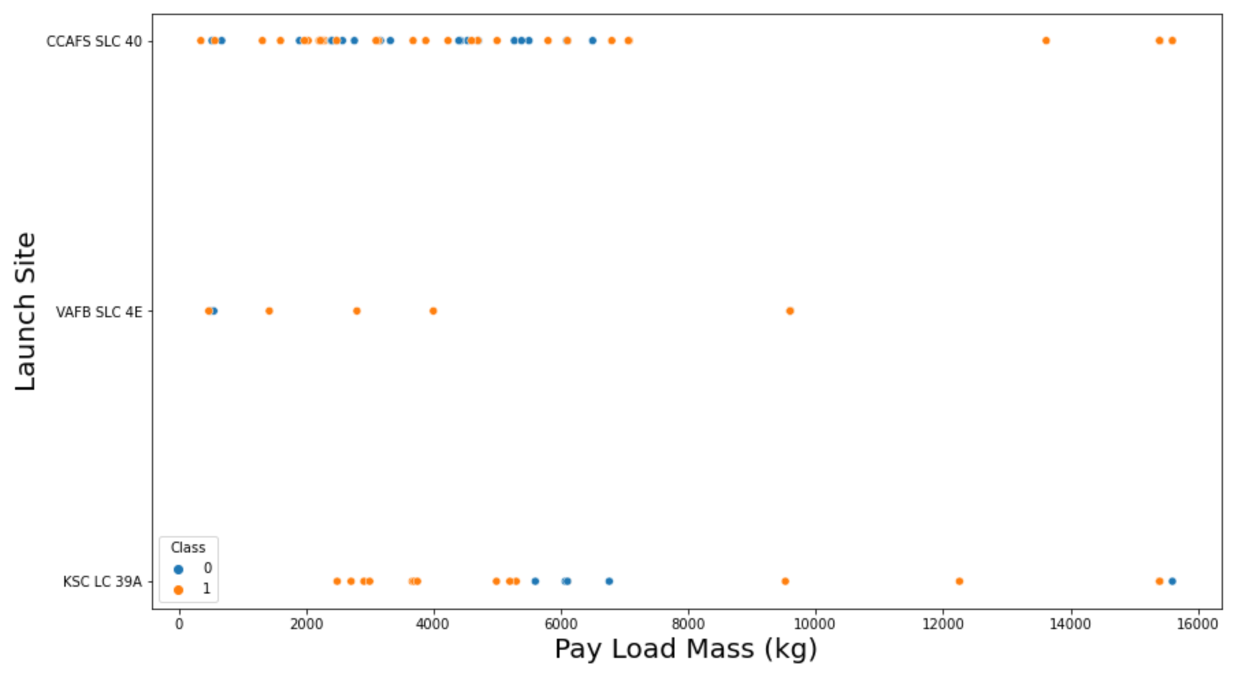
RESULTS Matplotlib and Seaborn (EDA with Visualization)
The relationship between payload mass and launch site

Slide 23
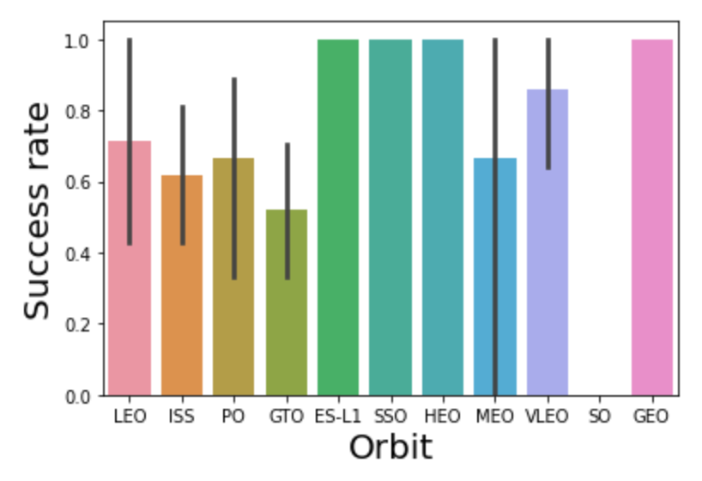
RESULTS Matplotlib and Seaborn (EDA with Visualization)
The relationship between success rate and orbit type

Slide 24
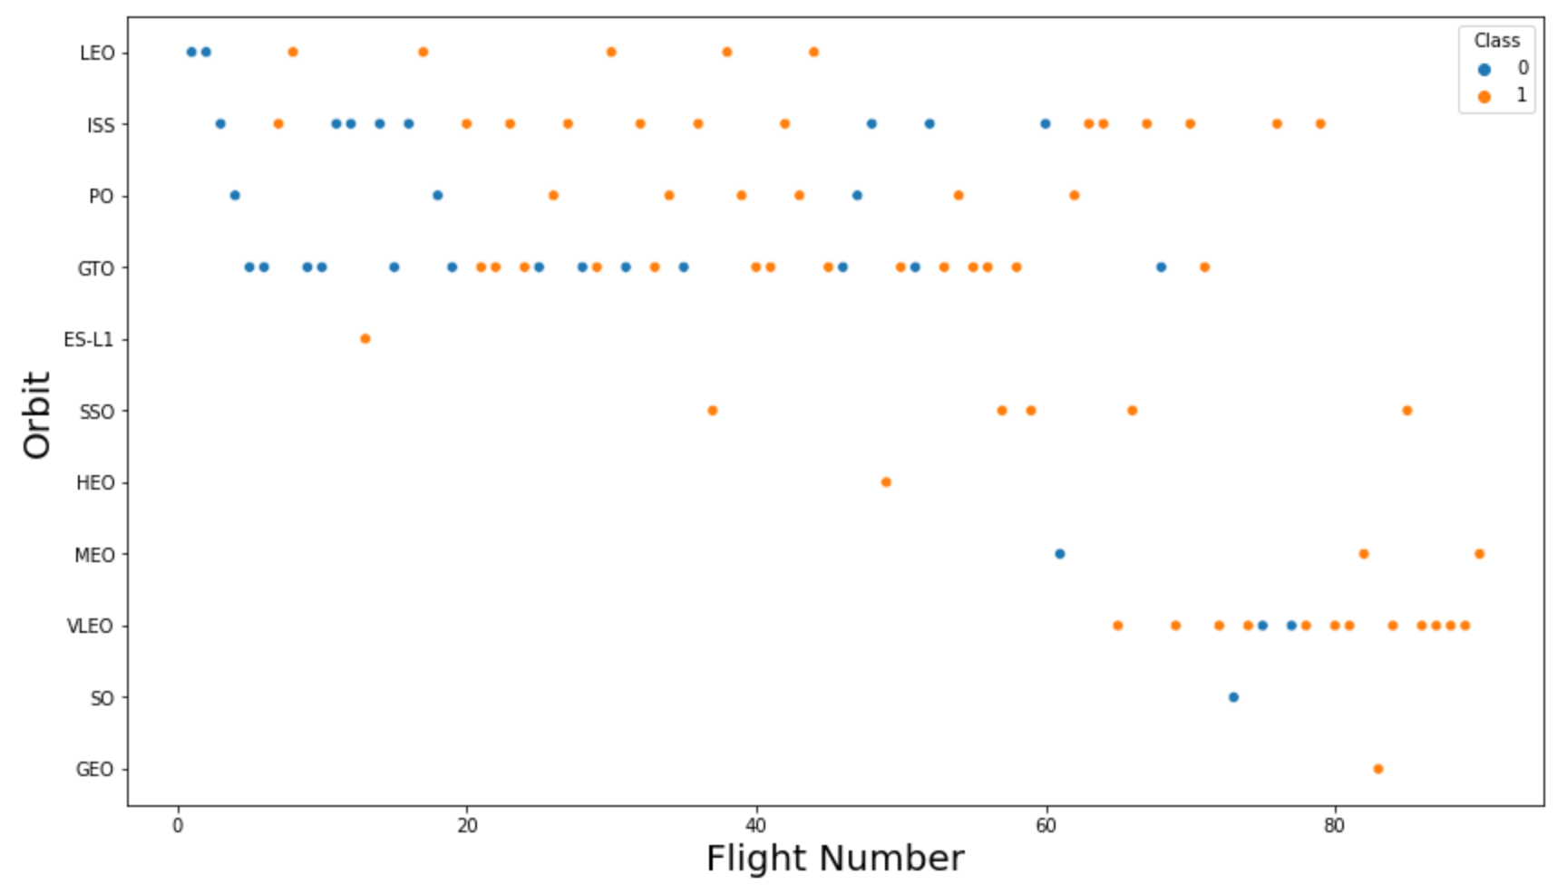
RESULTS Matplotlib and Seaborn (EDA with Visualization)
The relationship between flight number and orbit type

Slide 25
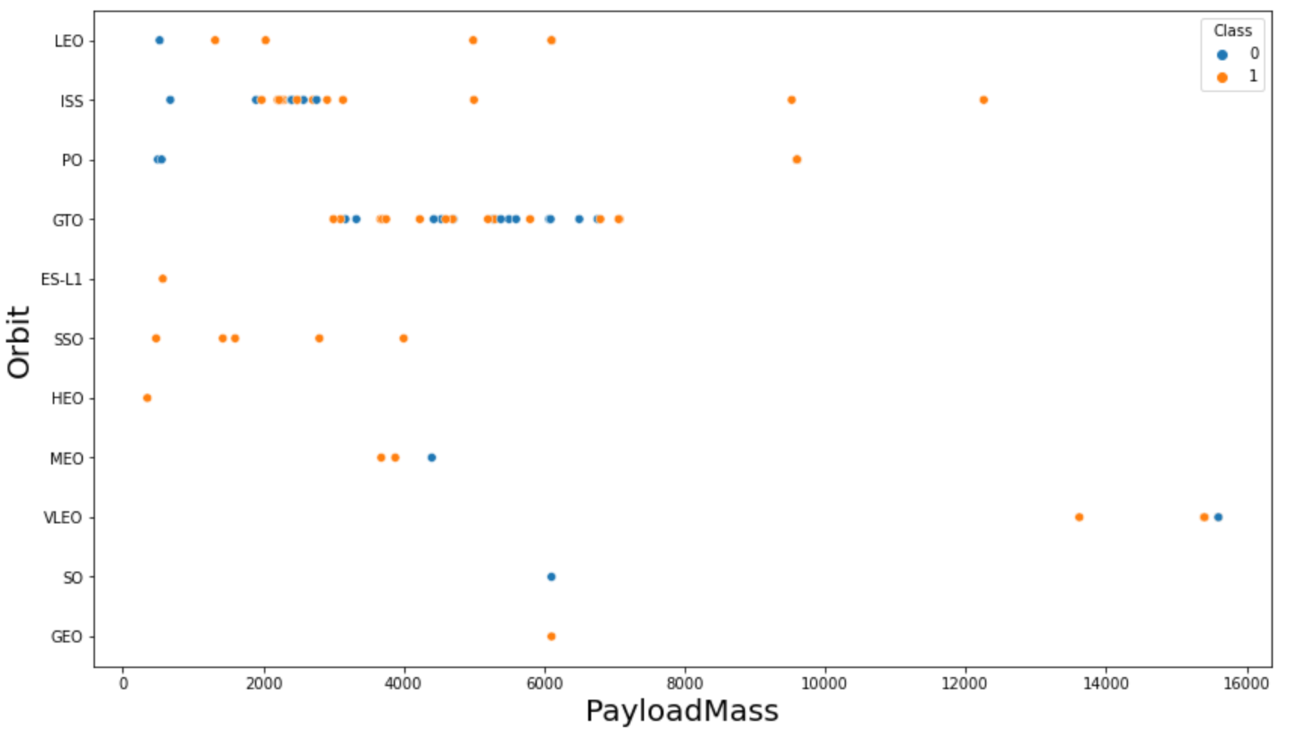
RESULTS Matplotlib and Seaborn (EDA with Visualization)
The relationship between payload mass and orbit type

Slide 26
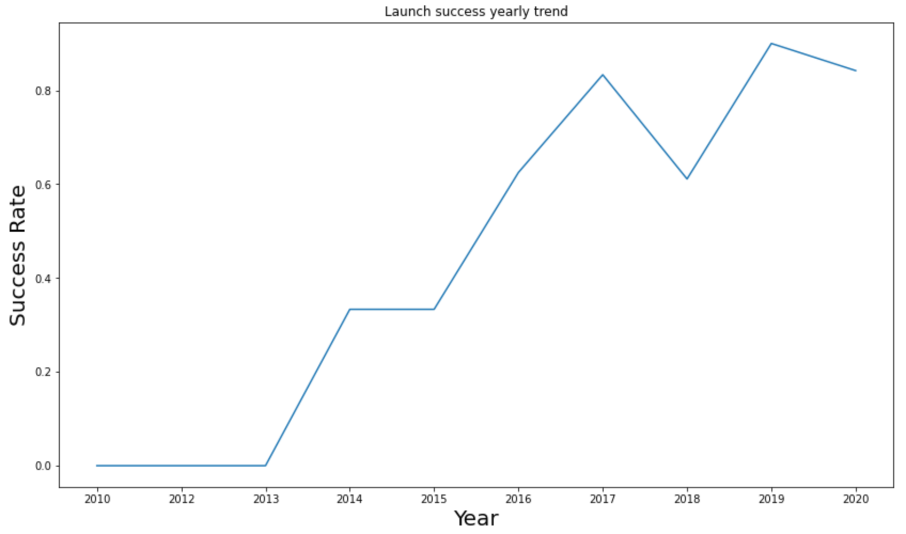
RESULTS Matplotlib and Seaborn (EDA with Visualization)
The launch success yearly trend

Slide 27
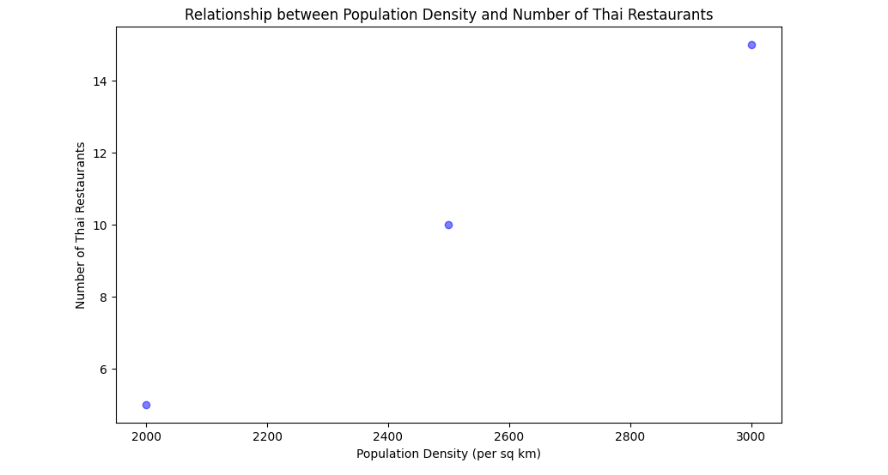
RESULTS Matplotlib and Seaborn (EDA with Visualization)
RESULTS
SQL (EDA with SQL)

Slide 28
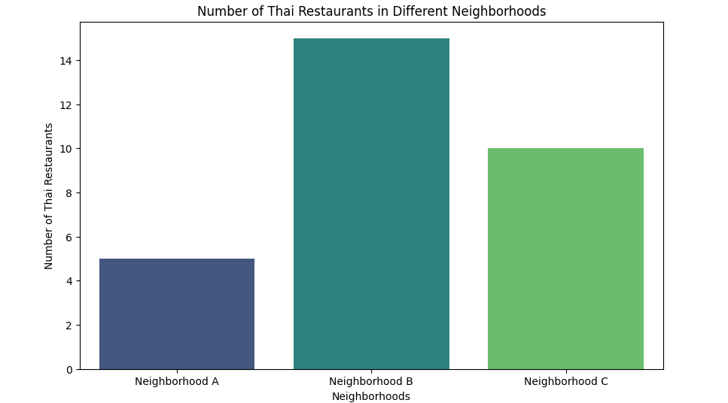
RESULTS Matplotlib and Seaborn (EDA with Visualization)
RESULTS
SQL (EDA with SQL)

Slide 29
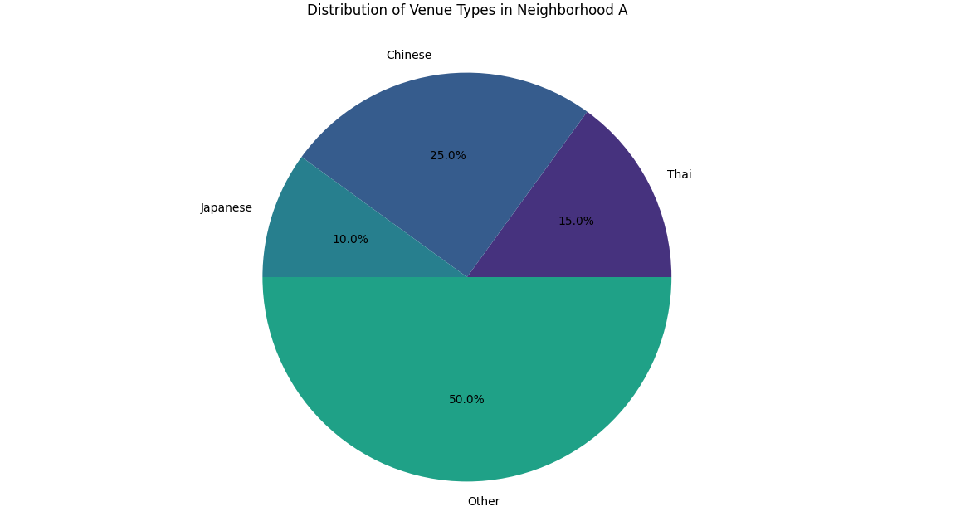
RESULTS Matplotlib and Seaborn (EDA with Visualization)
RESULTS
SQL (EDA with SQL)

Slide 30
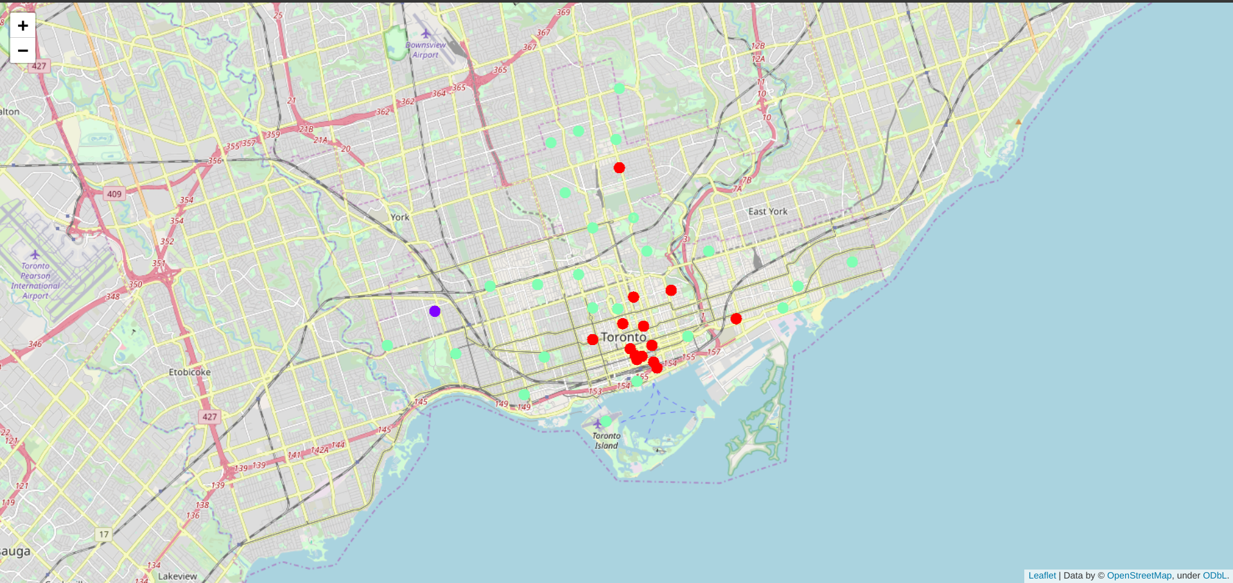
RESULTS Folium
The succeeded launches and failed launches for each site on map
If we zoom in on one of the launch site, we can see green and red tags. Each green tag represents a successful launch while each red tag represents a failed launch

Slide 31
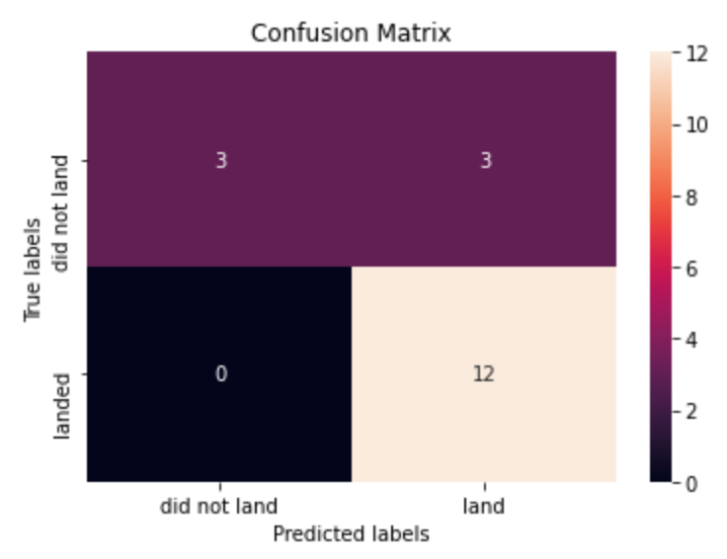
RESULTS Predictive Analysis
Logistic regression
GridSearchCV best score: 0.8464285714285713
Accuracy score on test set: 0.8333333333333334
Confusion matrix:

Slide 32
RESULTS Predictive Analysis
Support vector machine (SVM)
GridSearchCV best score: 0.8482142857142856
Accuracy score on test set: 0.8333333333333334
Confusion matrix:

Slide 33
RESULTS Predictive Analysis
Decision tree
GridSearchCV best score: 0.8892857142857142
Accuracy score on test set: 0.8333333333333334
Confusion matrix:

Slide 34
RESULTS Predictive Analysis
K nearest neighbors (KNN)
GridSearchCV best score: 0.8482142857142858
Accuracy score on test set: 0.8333333333333334
Confusion matrix:

Slide 35
RESULTS Predictive Analysis
Putting the results of all 4 models side by side, we can see that they all share the same accuracy score and confusion matrix when tested on the test set.
Therefore, their GridSearchCV best scores are used to rank them instead. Based on the GridSearchCV best scores, the models are ranked in the following order with the first being the best and the last one being the worst:
Decision tree (GridSearchCV best score: 0.8892857142857142)
K nearest neighbors, KNN (GridSearchCV best score: 0.8482142857142858)
Support vector machine, SVM (GridSearchCV best score: 0.8482142857142856)
Logistic regression (GridSearchCV best score: 0.8464285714285713)

Slide 36
DISCUSSION
From the data visualization section, we can see that some features may have correlation with the mission outcome in several ways. For example, with heavy payloads the successful landing or positive landing rate are more for orbit types Polar, LEO and ISS. However, for GTO, we cannot distinguish this well as both positive landing rate and negative landing(unsuccessful mission) are both there here.
Therefore, each feature may have a certain impact on the final mission outcome. The exact ways of how each of these features impact the mission outcome are difficult to decipher. However, we can use some machine learning algorithms to learn the pattern of the past data and predict whether a mission will be successful or not based on the given features.

Slide 37
Conclusion
In this project, we have gone through the process of identifying the business problem, specifying the data required, extracting and preparing the data, performing the machine learning by utilizing k-means clustering and providing recommendation to the stakeholder
The predictive model produced by decision tree algorithm performed the best among the 4 machine learning algorithms employed.

